Slide 1

Software Design and Arcitecture(SDA) Lecture 8
Engr.Ramsha Mashood
Senior Lecturer
Department of Software Engineering
Bahria University Karachi Campus

Slide 2




Behavioral patterns

Slide 3

What is design pattern

Slide 4
DEFINITION
Each Pattern describes a problem which occurs over and over again, and then describes the core of the solution to that problem, in such a way that you can use that solution million times over, with out ever doing it the same way twice.
(Christopher Alexander)
(Book: Design Pattern by Erich Gamma | Richard Helm)

Slide 5
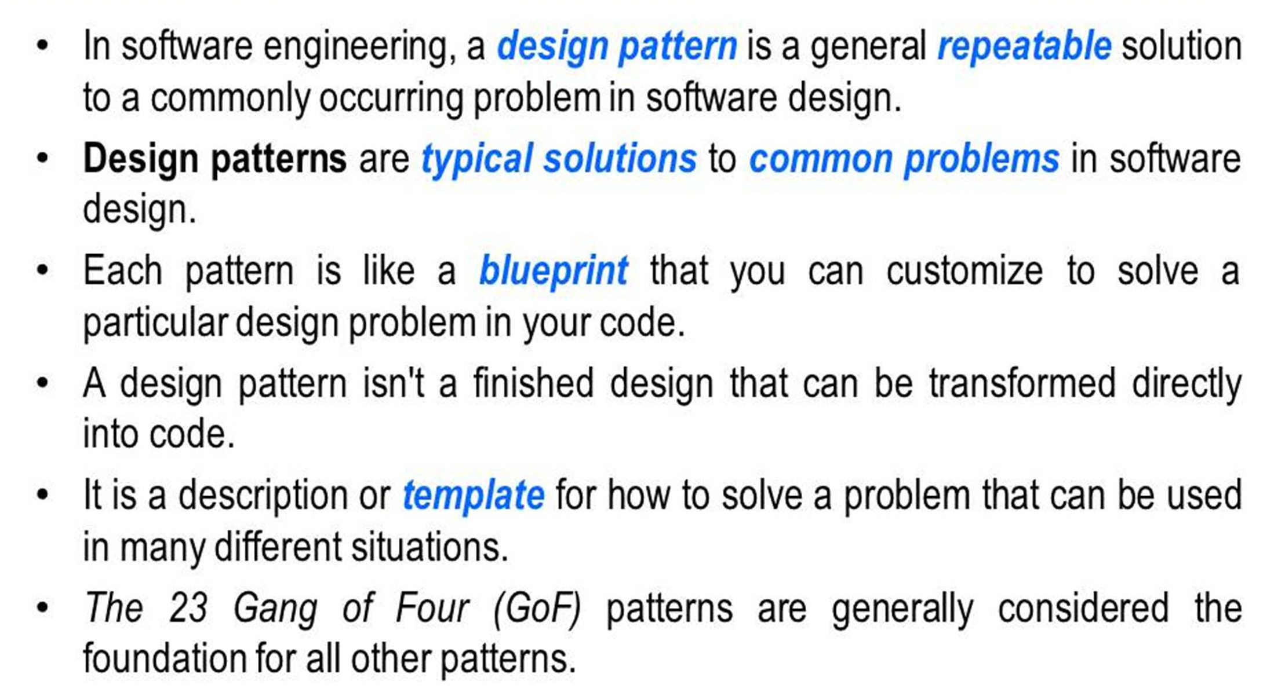
Design pattern

Slide 6
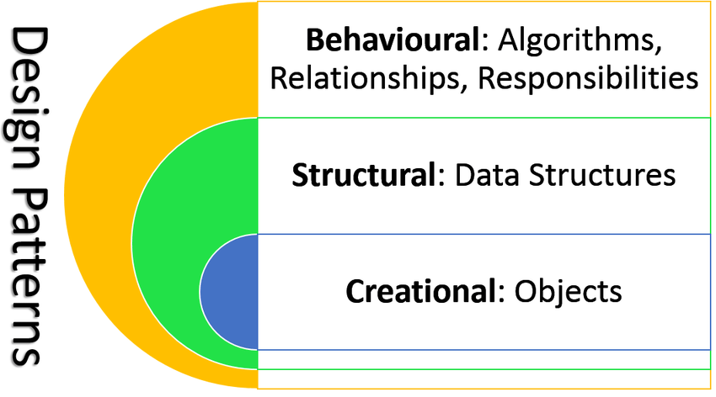

Slide 7
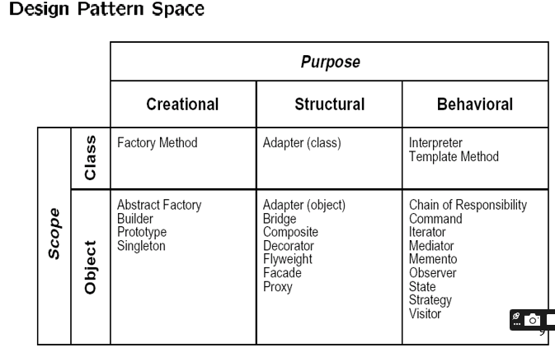

Slide 8
Classification of design patterns
Creational patterns provide object creation mechanisms that increase flexibility and reuse of existing code.
Structural patterns explain how to assemble objects and classes into larger structures, while keeping these structures flexible and efficient.
Behavioral patterns take care of effective communication and the assignment of responsibilities between objects.

Slide 9
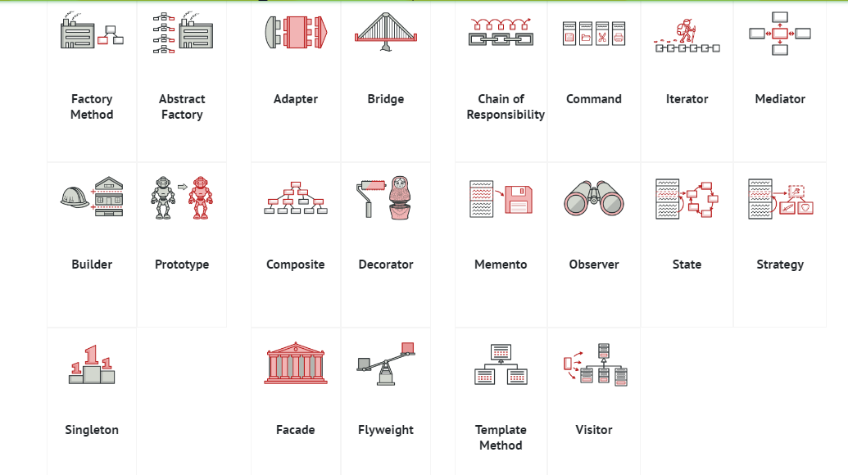
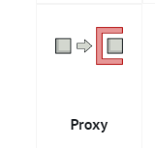
classification

Slide 10

Behavioral pattern

Slide 11
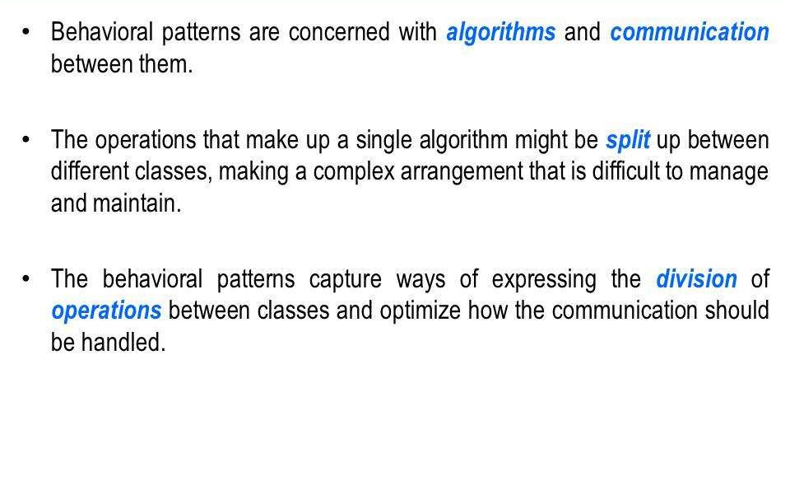
Behavioral pattern

Slide 12
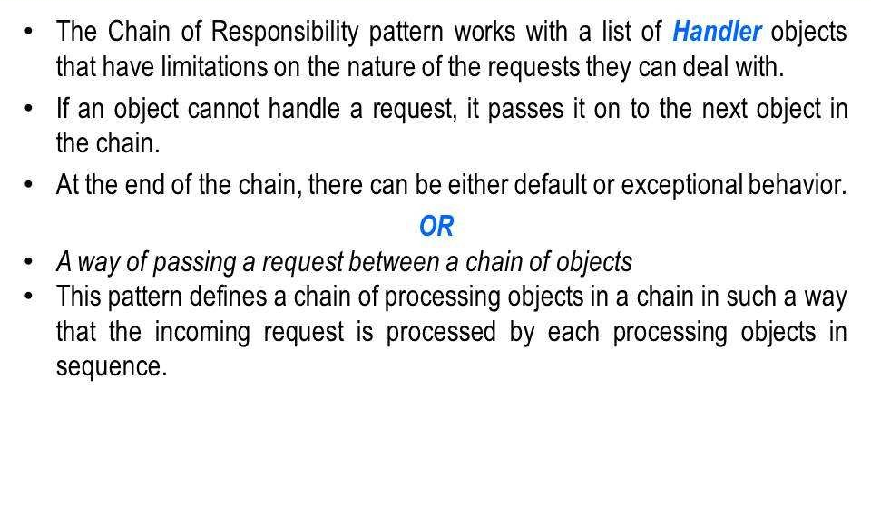
Chain of Responsibility pattern

Slide 13
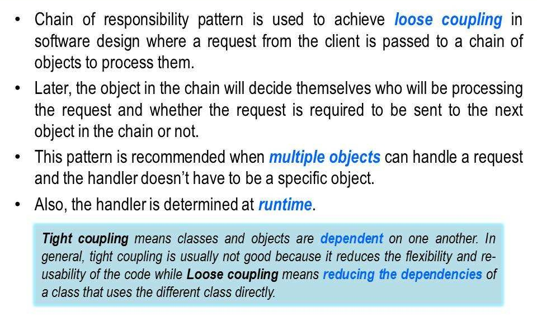
Chain of Responsibility pattern

Slide 14
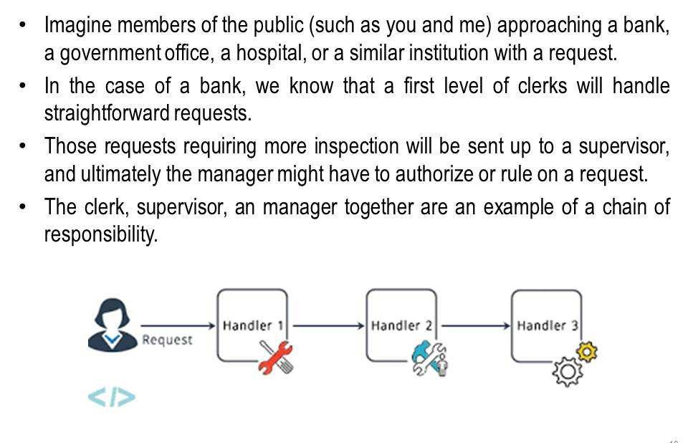
Chain of Responsibility Example

Slide 15
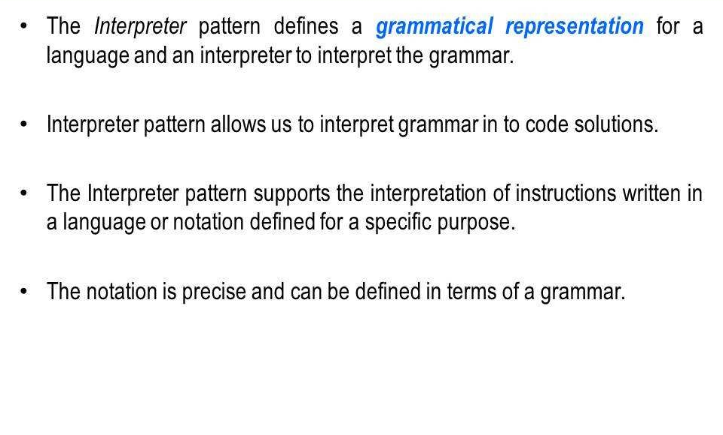
Interpreter pattern

Slide 16
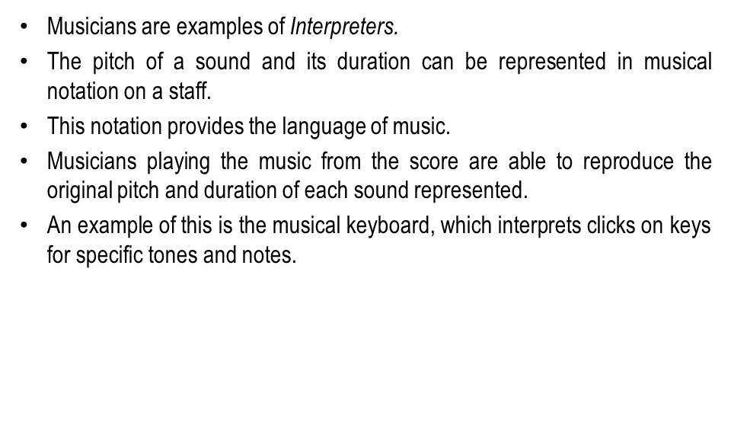
Interpreter pattern

Slide 17
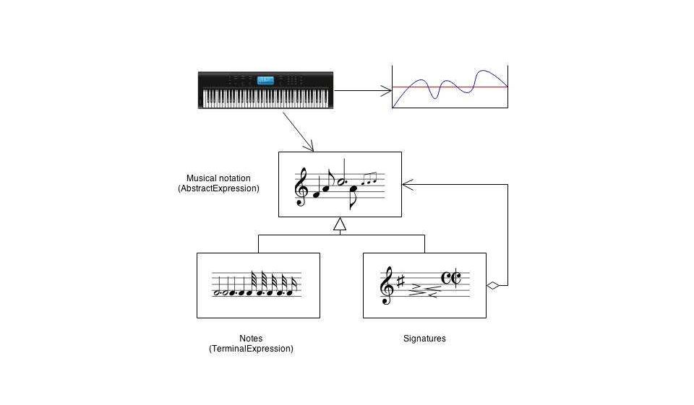
Interpreter pattern Example

Slide 18
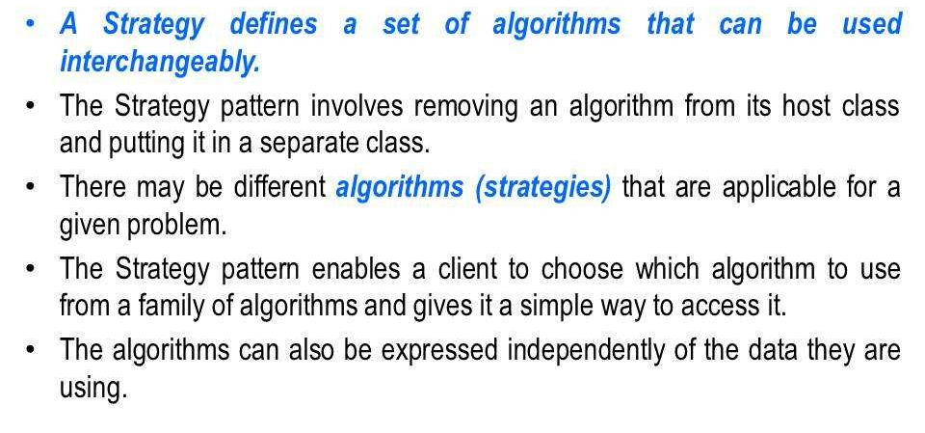
Strategy pattern

Slide 19
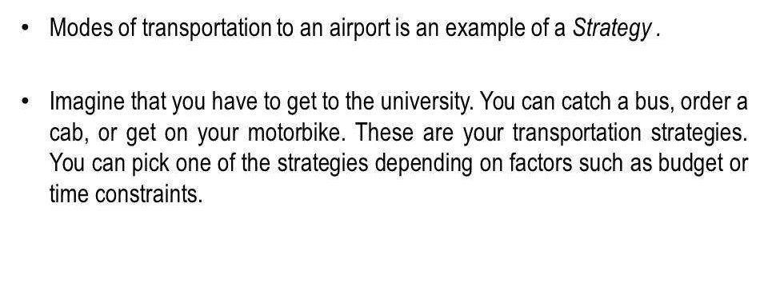
Interpreter pattern

Slide 20
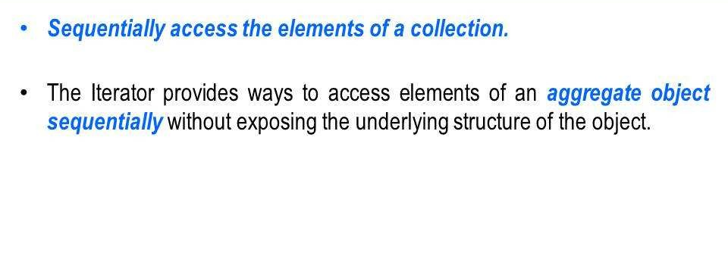
Iterator pattern

Slide 21
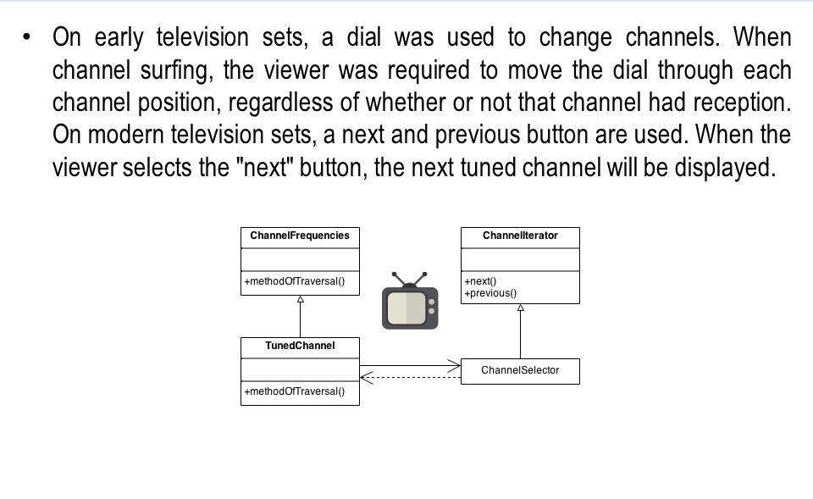
Iterator pattern Example

Slide 22
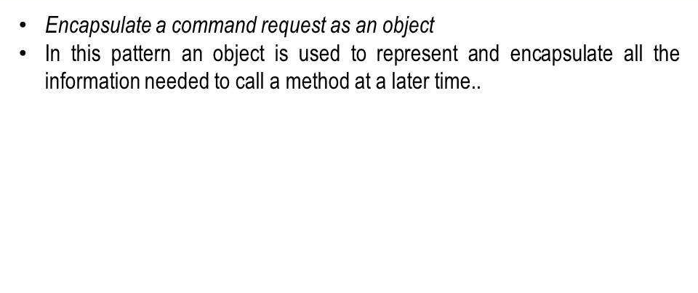
Command Design pattern

Slide 23
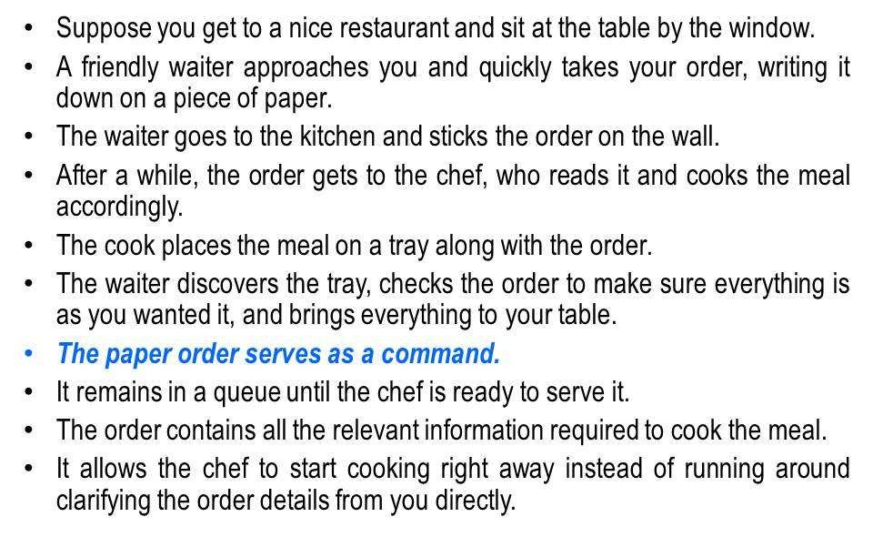
Command Design pattern

Slide 24
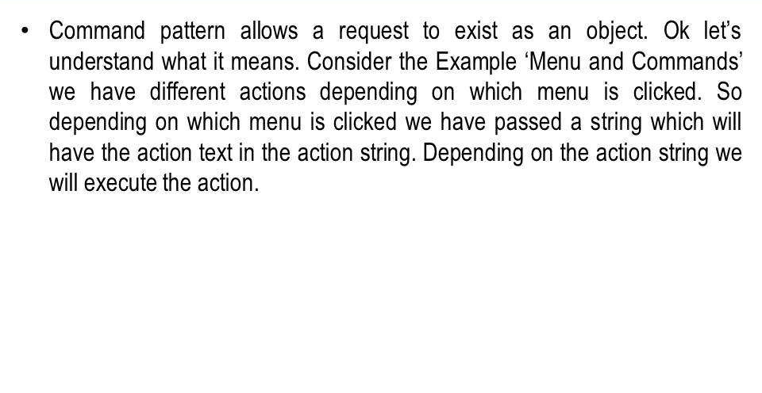
Command Design pattern

Slide 25
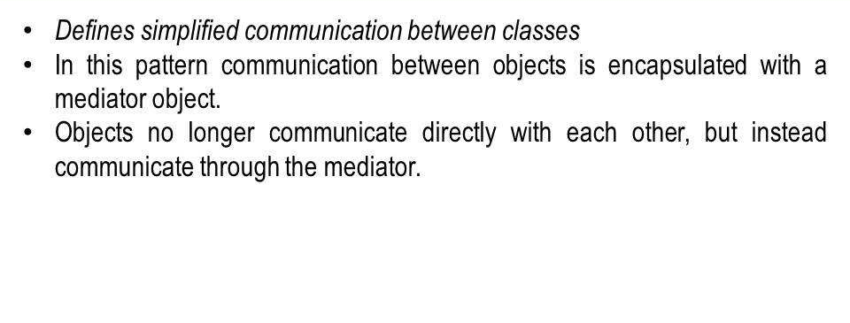
Mediator pattern

Slide 26
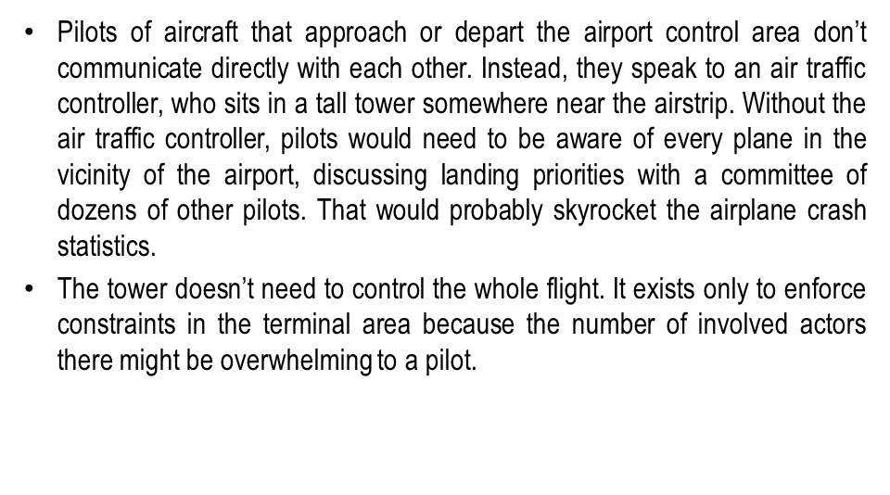
Mediator pattern Example

Slide 27
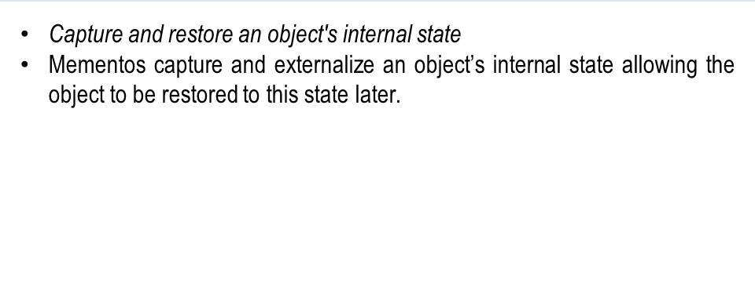
Mementos pattern

Slide 28
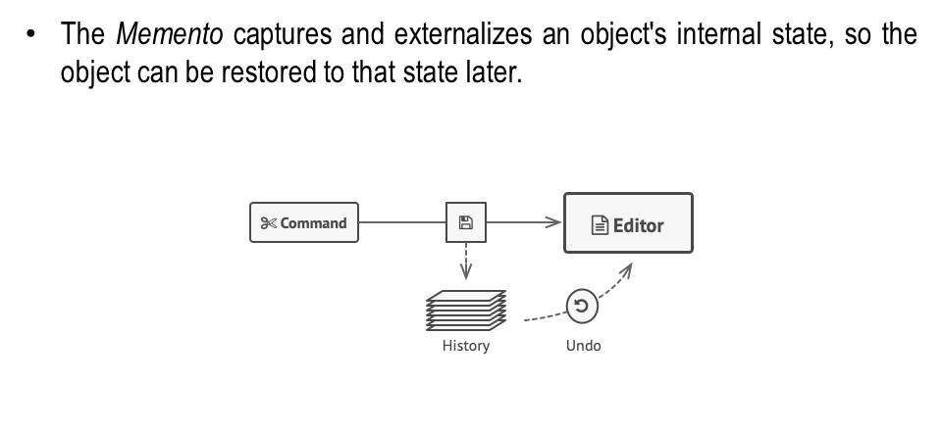
Mementos pattern

Slide 29
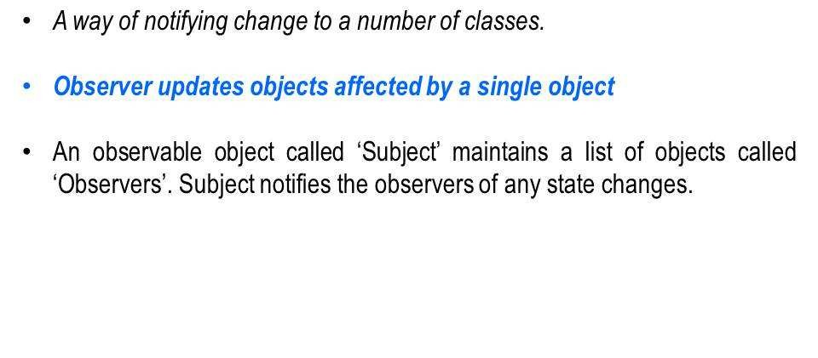
Observer pattern

Slide 30
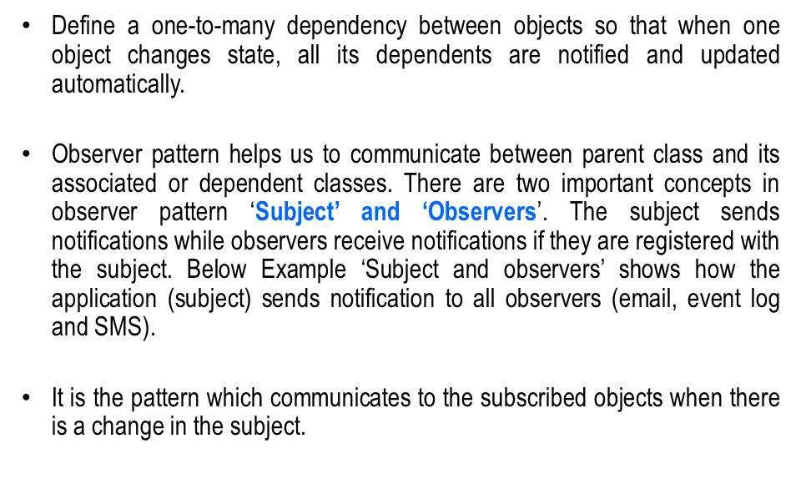
Observer pattern

Slide 31
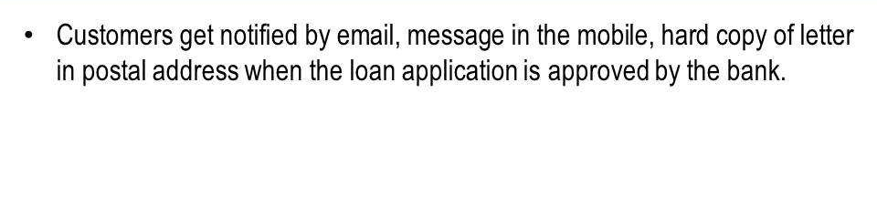
Observer pattern

Slide 32
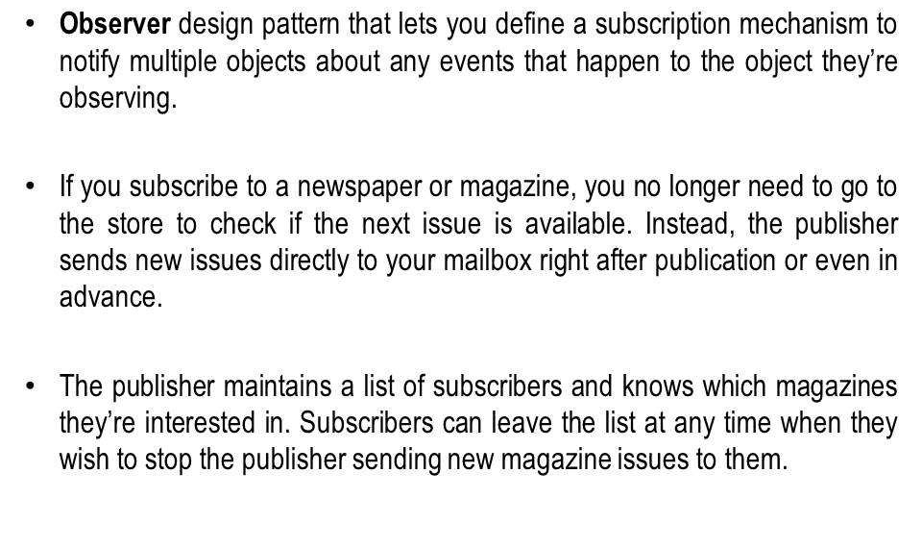
Observer pattern

Slide 33
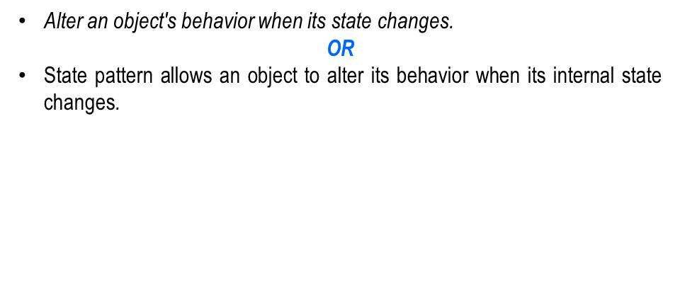
State Design pattern

Slide 34
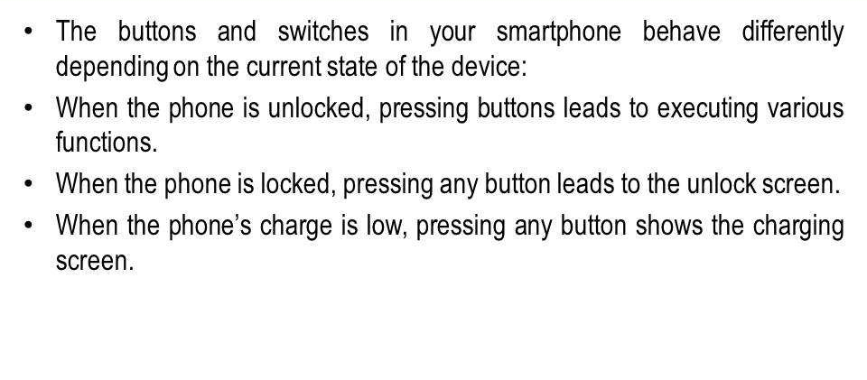
State Design pattern

Slide 35
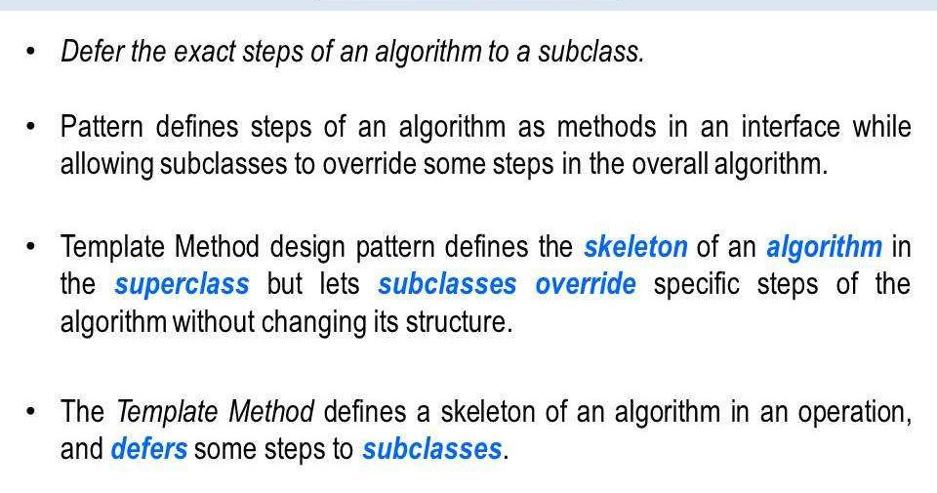
Template pattern

Slide 36
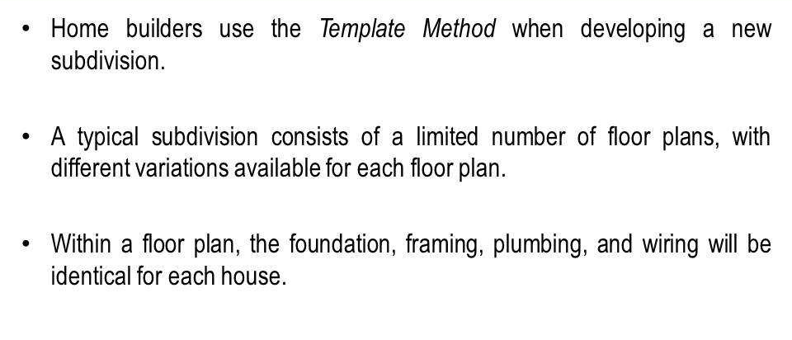
Template Method pattern

Slide 37
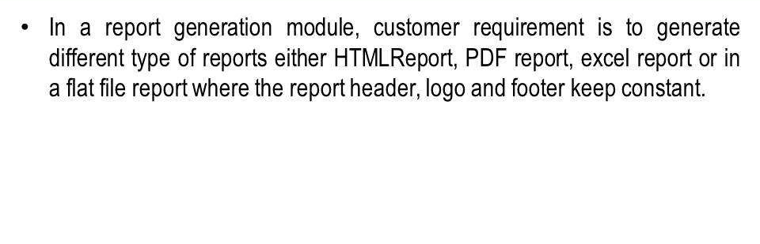
Template Method Pattern Example

Slide 38
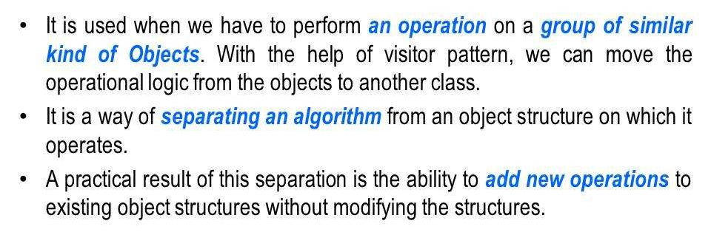
Visitor Design pattern

Slide 39
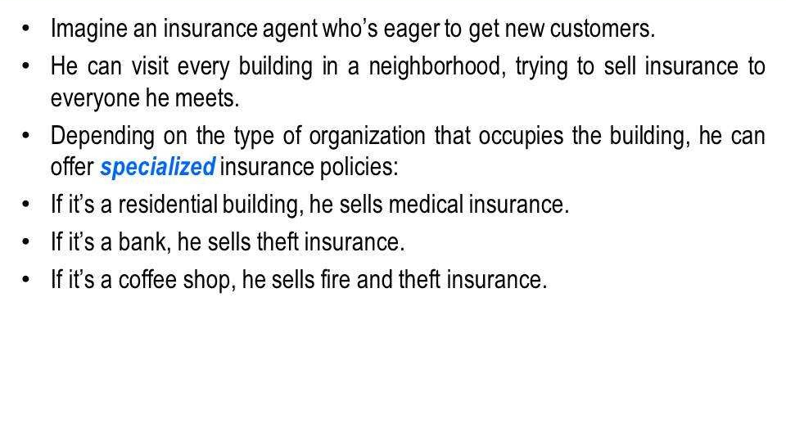
Visitor Design Pattern

Slide 40
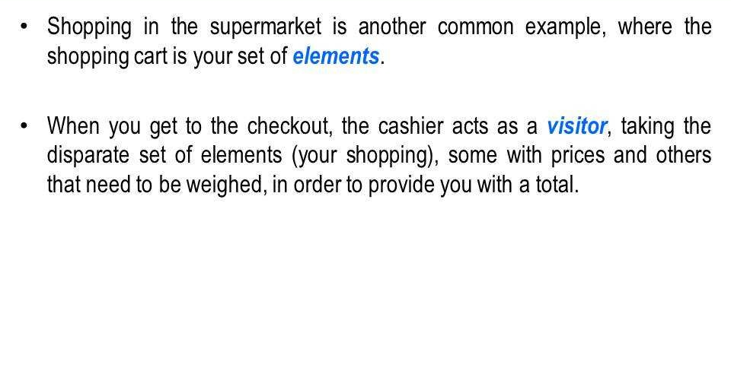
Visitor Design pattern

Slide 41
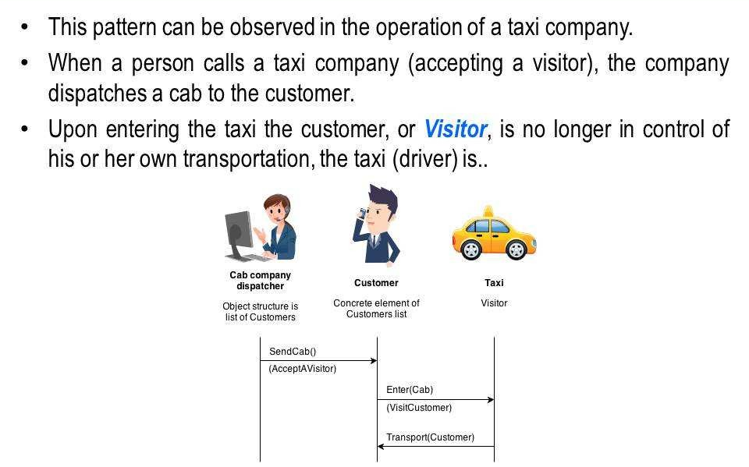
Visitor Design pattern

Slide 42
Useful links
https://refactoring.guru/design-patterns
https://sourcemaking.com/design_patterns

Slide 43
Continue….
Any thing to ask ??

